Slide 1
Oracle Cloud Infrastructure
Oracle Public Cloud Network
Notes:
Thank you for taking the time to meet with me today to discuss how we can help your business with Oracle Cloud Infrastructure.

Slide 2
Agenda
OCI Networking Core Components
WAN Connectivity on-prem / OCI (VPN, FastConnect)
Intra-OCI region Azure Interconnect
Your network requirements
(optional) Advanced network configurations

Slide 3
Safe harbor statement
The following is intended to outline our general product direction. It is intended for information purposes only, and may not be incorporated into any contract. It is not a commitment to deliver any material, code, or functionality, and should not be relied upon in making purchasing decisions.
The development, release, timing, and pricing of any features or functionality described for Oracle’s products may change and remains at the sole discretion of Oracle Corporation.
Copyright © 2019, Oracle and/or its affiliates. All rights reserved.

Slide 4
OCI Core Components
Region 1
Region 2
Fault Domains
Availability Domains
Regions
Protection against failures within datacenters
Protection from entire datacenter failures
Protection from disaster with Data Residency compliance
SLAs on Performance, Management and Availability

Slide 5
Virtual Cloud Network

Slide 6
Virtual Cloud Network (VCN)
A private network that you set up in the Oracle data centers, with firewall rules and specific types of communication gateways that you can choose to use
A VCN covers contiguous IPv4 CIDR blocks of your choice
A VCN resides within a single region

Slide 7

Subnet
Each VCN network is subdivided into subnets
Each subnet can be AD-specific or Regional (recommended)
AD specific subnet is contained within a single AD in a multi-AD region
Regional subnet spans all three ADs in a multi-AD region
Each subnet has a contiguous range of IPs, described in CIDR notation. Subnet IP ranges cannot overlap
Instances are placed in subnets and draw their internal IP address and network configuration from their subnet
Subnets can be designated as either
Private (instances contain private IP addresses assigned to VNICs)
Public (contain both private and public IP addresses assigned to VNICs)
VNIC is a component that enables a compute instance to connect to a VCN. The VNIC determines how the instance connects with endpoints inside and outside the VCN
ORACLE CLOUD DATA CENTER REGION
AVAILABILITY DOMAIN-1
AVAILABILITY DOMAIN-2
AVAILABILITY DOMAIN-3
SUBNET A, 10.0.1.0/24
SUBNET B, 10.0.2.0/24
SUBNET C, 10.0.3.0/24
SUBNET D
10.0.4.0/24
VCN, 10.0.0.0/16

Slide 8
Internet Gateway
ORACLE CLOUD DATA CENTER REGION
Internet gateway provides a path for network traffic between your VCN and the internet
Availability Domain – AD1
Internet
Instance with public IP
SUBNET A, 10.0.1.0/24
Internet Gateway
You can have only one internet gateway for a VCN
After creating an internet gateway, you must add a route for the gateway in the VCN's Route Table to enable traffic flow
Regional Public Subnet
VCN, 10.0.0.0/16

Slide 9

Route Table
ORACLE CLOUD DATA CENTER REGION
Route Table is used to send traffic out of the VCN
Availability Domains – AD1
Internet
Destination CIDR | Route Target
0.0.0.0/0 | Internet Gateway
SUBNET A, 10.0.1.0/24
Route Table
Internet Gateway
Regional Public Subnet
Consists of a set of route rules; each rule specifies
Destination CIDR block
Route Target (the next hop) for the traffic that matches that CIDR
VCN, 10.0.0.0/16
All traffic destined for Internet Gateway

Slide 10
NAT Gateway
NAT gateway gives an entire private network access to the internet without assigning each host a public IP address
ORACLE CLOUD DATA CENTER REGION
Availability Domains – AD1
Internet
Destination CIDR | Route Target
0.0.0.0/0 | NAT Gateway
SUBNET A, 10.0.1.0/24
NAT Gateway
Instance with private IP
Hosts can initiate outbound connections to the internet and receive responses, but not receive inbound connections initiated from the internet. Use case: updates, patches)
You can have more than one NAT gateway on a VCN, though a given subnet can route traffic to only a single NAT gateway
Regional Private Subnet
VCN, 10.0.0.0/16

Slide 11
Service Gateway
ORACLE CLOUD DATA CENTER REGION
Service gateway lets resources in VCN access public OCI services, exposed on the Oracle Services Network, such as Object Storage, but without using either Internet or NAT gateway
Object Storage
AD1
Service Gateway
Any traffic from VCN that is destined for one of the supported OCI public services uses the instance's private IP address for routing, travels over OCI network fabric, and never traverses the internet. Use case: back up DB Systems in VCN to Object Storage)
SUBNET A, 10.0.1.0/24
Destination CIDR | Route Target
Service CIDR Label | Service Gateway
Regional Private Subnet
VCN, 10.0.0.0/16
Service CIDR labels represent all the public CIDRs for a given Oracle service or a group of Oracle services. E.g.
OCI <region> Object Storage
All <region> Services

Slide 12
Dynamic Routing Gateway
ORACLE CLOUD DATA CENTER REGION
A virtual router that provides a path for private traffic between your VCN and destinations other than the internet
You can use it to establish a connection with your on-premises network via IPsec VPN or FastConnect (private, dedicated connectivity)
After attaching a DRG, you must add a route for the DRG in the VCN's route table to enable traffic flow
DRG is a standalone object. You must attach it to a VCN. VCN and DRG have n:1 relationship
AD
Destination CIDR | Route Target
172.16.0.0/16 | DRG
SUBNET B, 10.0.2.0/24
VCN, 10.0.0.0/16
Regional Private Subnet
CUSTOMER DATA CENTER
Customer Premises Equipment (CPE)
Remote Private Network, 172.16.0.0/16

Slide 13
Local Peering
VCN peering is the process of connecting multiple VCNs
Local VCN peering is the process of connecting two VCNs in the same region so that their resources can communicate using private IP addresses
A local peering gateway (LPG) is a component on a VCN for routing traffic to a locally peered VCN
The two VCNs in the peering relationship shouldn’t have overlapping CIDRs
Destination CIDR | Route Target
192.168.0.0/16 | LPG-1
Destination CIDR | Route Target
10.0.0.0/16 | LPG-2
ORACLE CLOUD DATA CENTER REGION
VCN-1,
10.0.0.0/16
VCN-2,
192.168.0.0/16
LPG-1
LPG-2

Slide 14
Remote Peering
Destination CIDR | Route Target
192.168.0.0/16 | DRG-1
Remote VCN peering is the process of connecting two VCNs in different regions or in the same region so that their resources can communicate using private IP addresses
Requires a remote peering connection (RPC) to be created on the DRGs. RPC's job is to act as a connection point for a remotely peered VCN
The two VCNs in the peering relationship must not have overlapping CIDRs
Destination CIDR | Route Target
10.0.0.0/16 | DRG-2
OCI REGION ASH
OCI REGION PHX
Oracle backbone
VCN-1,
10.0.0.0/16
VCN-2,
192.168.0.0/16

Slide 15
Security List (SL)
A common set of firewall rules associated with a subnet and applied to all instances launched inside the subnet
Security list consists of rules that specify the types of traffic allowed in and out of the subnet
To use a given security list with a particular subnet, you associate the security list with the subnet either during subnet creation or later.
Security list apply to a given instance whether it's talking with another instance in the VCN or a host outside the VCN
You can choose whether a given rule is stateful or stateless
Stateful Rules enable a Connection Tracking mechanism. When an instance receives traffic matching the stateful ingress rule, the response is tracked and automatically allowed regardless of any egress rules; similarly for sending traffic from the host
Stateless rules: response traffic is not automatically allowed. To ow the response traffic for a stateless ingress rule, you must create a corresponding stateless egress rule
 | Direction | CIDR | Protocol | Source Port | Dest Port
Stateful | Ingress | 0.0.0.0/0 | TCP | All | 80
Stateful | Egress | 10.0.2.0/24 | TCP | All | 1521
Security List
Security List
Security List
SUBNET A, 10.0.1.0/24
SUBNET B, 10.0.2.0/24
SUBNET C, 10.0.2.0/24
VCN, 10.0.0.0/16

Slide 16

Network Security Group (NSG)
 |  | Direction | CIDR | Protocol | Source Port | Dest Port
NSG-A | Stateful | Ingress | 0.0.0.0/0 | TCP | All | 80
NSG-B | Stateful | Ingress | 0.0.0.0/0 | TCP | All | 22
A network security group (NSG) provides a virtual firewall for a set of cloud resources that all have the same security posture
NSG consists of set of rules that apply only to a set of VNICs of your choice in a single VCN
Currently, compute instances, load balancers and DB instances support NSG
When writing rules for an NSG, you can specify an NSG as the source or destination. Contrast this with SL rules, where you specify a CIDR as the source or destination
Oracle recommends using NSGs instead of SLs because NSGs let you separate the VCN's subnet architecture from your application security requirements
SUBNET A, 10.0.1.0/24
SUBNET B, 10.0.1.0/24
NSG-A
NSG-B
NSG-A
VCN, 10.0.0.0/16

Slide 17
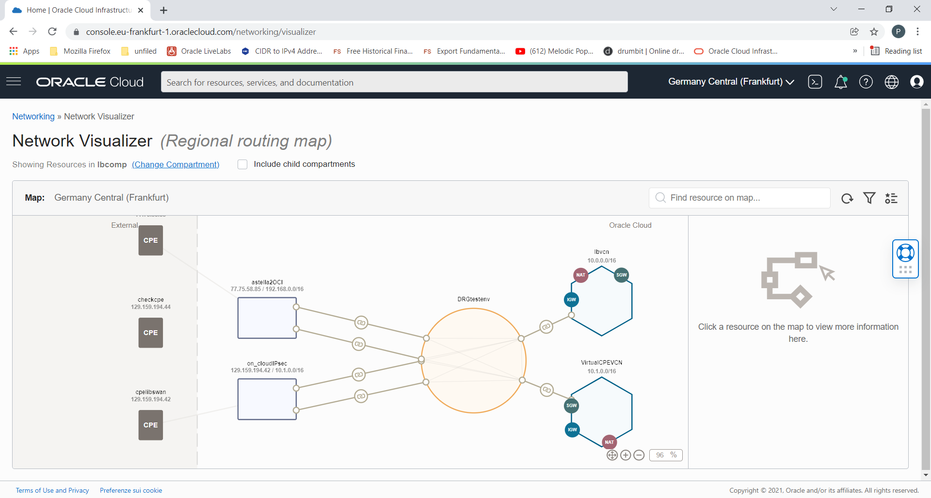
Network Visualizer v2.0

Slide 18
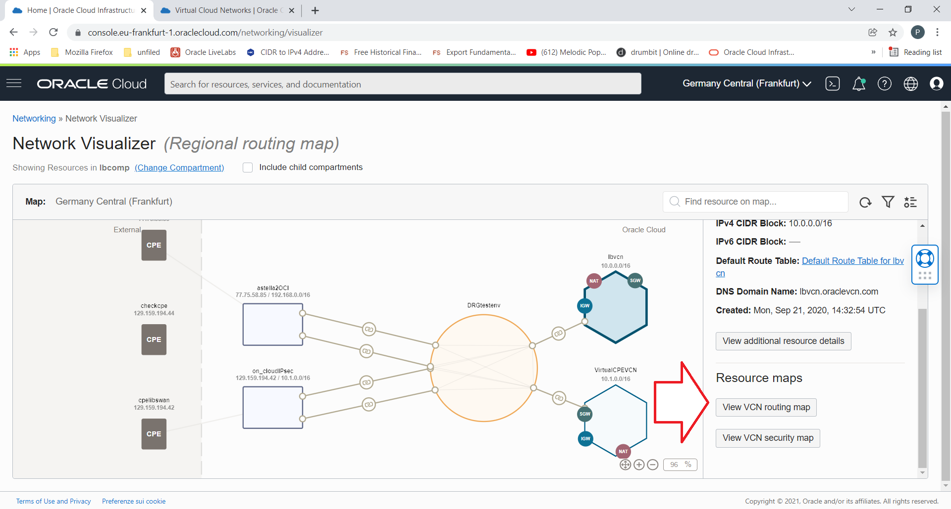
Network Visualizer v2.0

Slide 19
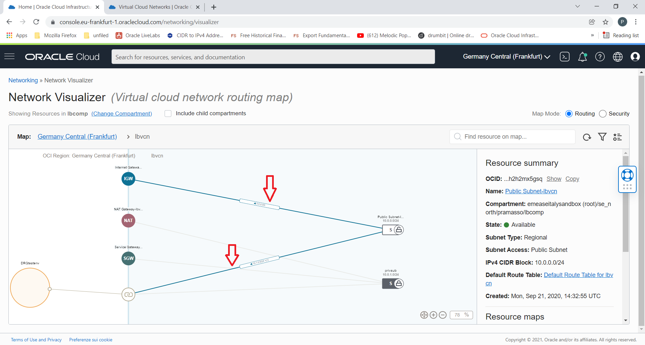
Network Visualizer v2.0

Slide 20
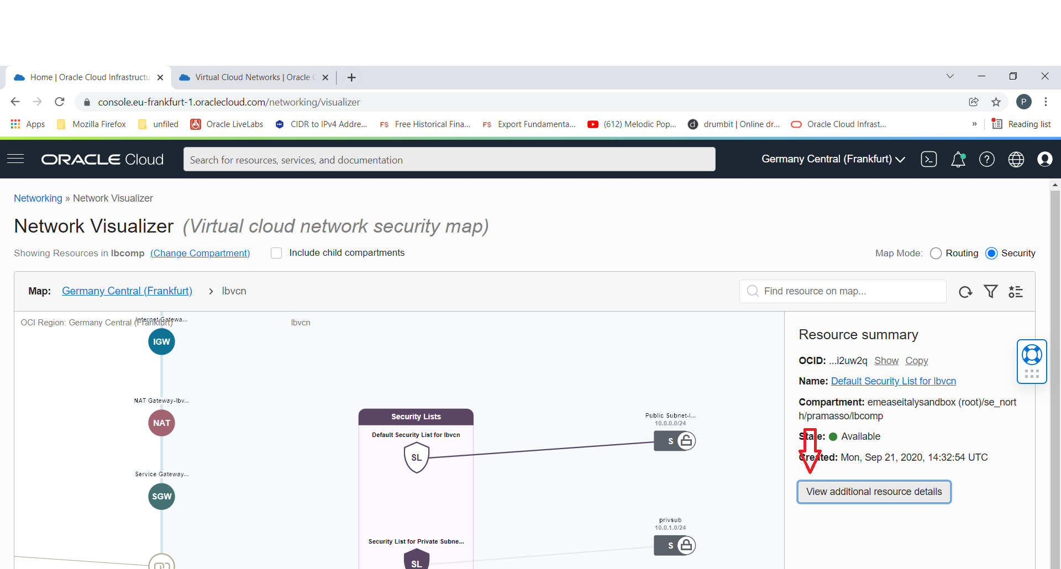
Network Visualizer v2.0

Slide 21
Load Balancer
VCN
AVAILABILITY DOMAIN-1
AVAILABILITY DOMAIN-2
Public IP address
Regional Subnet 1
Listener
Load Balancer
(Active)
Load Balancer Pair
Load Balancer (Failover)
Regional Subnet 2
Backend Set
Backend Servers
Backend Servers

Slide 22
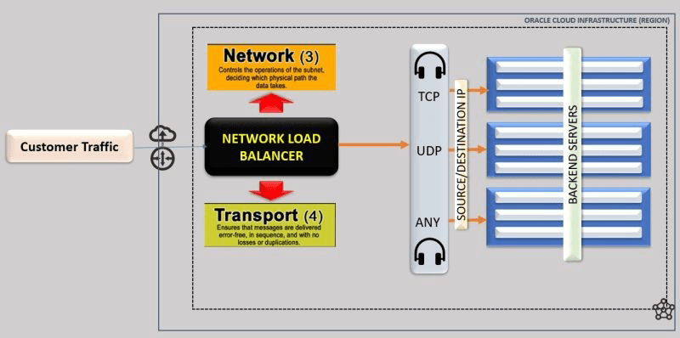
Network Load Balancer
It can be public or private and regional scoped
It’s an always Free Service
Every Load balancer configuration limits:
One IP address
50 backend sets
512 backend servers per backend set
1024 backend servers total
50 listeners

Slide 23

VPN Basics
VPN – using a public network to make end to end connection between two private networks in a secure fashion
Tunnel – a way to deliver packets through the internet to private RFC 1918 addresses
Authentication – provides a mechanism to authenticate who you are
Encryption – packets need to be encrypted, so they cannot be sniffed over the public internet
Static routing: configure a router to send traffic for particular destinations in preconfigured directions
Dynamic routing: use a routing protocol such as BGP to figure out what paths traffic should take
Tunnel
VPN Connection
Private
Network 1
Private
Network 2
Internet
VPN Router
VPN Router

Slide 24
VPN Connect (IPSec)
ORACLE CLOUD DATA CENTER REGION
VPN Connect is a managed VPN service which securely connects on-premises network to OCI VCN through an IPSec VPN connection
VPN Connect ensures secure remote connectivity via industry standard IPSec encryption
Bandwidth is dependent on the customer’s access to the Internet and general Internet congestion (Typically less than 250 Mbps – but your mileage may vary)
VPN Connect is offered for free
Customer Proof of Concepts usually start as a VPN and then morph into FastConnect designs
OCI provisions redundant VPN tunnels located on physically and logically isolate tunnel endpoints
VCN, 10.0.0.0/16
AVAILABILITY DOMAIN-2
SUBNET B,
10.0.2.0/24
Custom Route Table
CUSTOMER
DATA CENTER

Slide 25


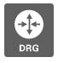
VPN Connect (IPSec) - Workflow
Route Table
10.0.0.0/16 → DRG
Static Route or Dynamic Routing (BGP)
OCI REGION
On-Premises Network
10.0.0.0/16
VCN, 172.16.0.0/16
SUBNET, 172.16.1.0/24
Internet
CPE,
142.32.45.56

Slide 26
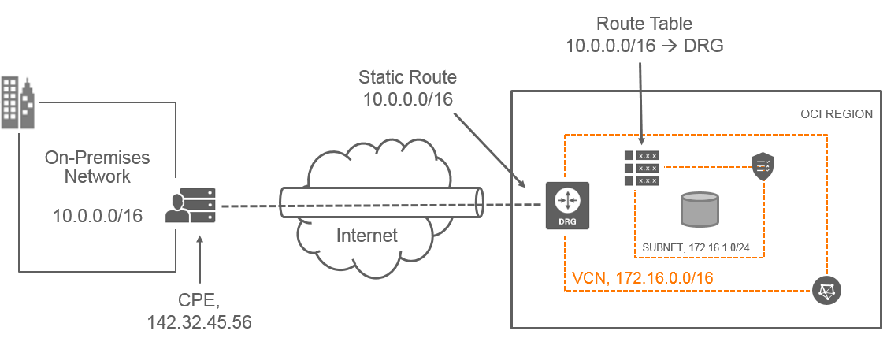
VPN Connect workflow
Create a Virtual Cloud Network (VCN)
Create a Dynamic Routing Gateway (DRG)
Attach DRG to your VCN
Update VCN Router to route traffic to DRG
Create a CPE Object and add on-premises router Public IP address
From DRG, Create an IPsec Connection between CPE and DRG and provide a Static Route or use BGP routing
Configure on-premises CPE Router

Slide 27

FastConnect
Dedicated, private, secure network connectivity to connect customer locations to OCI.
Features
Multiple bandwidth options with FastConnect: through a Partner
1G or 10G, 100G port bandwidth options with FastConnect
Cost effective - No egress data transfer charges and lower port charges on hourly basis.
Private Peering – extends corporate network to Oracle Cloud
Public Peering – Internet alternative to connect to public Oracle Cloud resources
Oracle Cloud
FastConnect
Customer Location

Slide 28
FastConnect Models
1. Oracle FastConnect Partner Network
Direct connection between the customer and Oracle through a pre-established FastConnect partner
The most flexible and typically least expensive to set up
2. Direct Cross-connect - Colocation
Direct connection between the customer and Oracle when both are in the same FastConnect facility
Good model if the customer and Oracle are already colocated
3. Direct Cross-connect -Dedicated Circuits
Connection between the customer’s network provider and Oracle using a dedicated circuit
Least flexible and typically most expensive to set up
Notes:
FastConnect comes in three different models:
The most flexible model is connecting to Oracle through the FastConnect Partner Network
The direct cross-connect model via colocation is a good answer if your infrastructure and the Oracle Cloud are already in the same facility
The third model is relevant if neither of the first two models is available, and if your existing network provider isn’t already an Oracle partner

Slide 29


FastConnect: Through a Partner
Regional Cloud Services
FASTCONNECT LOCATION
Partner Demarc
Oracle CAGE
Point-to-point or
multi-point service
Subnet 1
FastConnect
Edge
PARTNER
NETWORK
Partner Edge
Redundant 10Gbps
Subnet 2
CPE
CUSTOMER
DATACENTER
Subnet 3
CPE
CUSTOMER
DATACENTER
Partners
Network Service Providers
Exchanges (e.g. Equinix, Megaport, Interxion)

Slide 30
Public Peering Internet Alternative
Private Peering Infrastructure Extension
FastConnect Peering
Connect to Public services like Object Storage or Public load balancer via FastConnect.
Public peering with FastConnect provides an alternative to public Internet access for customers to connect to their public resources in OCI.
Extend your existing infrastructure into Oracle Cloud Infrastructure resources using Private IPs in a virtual cloud network (VCN) accessed via FastConnect.

Slide 31
FastConnect Use Cases Summary
 | FastConnect-Private Peering Infrastructure Extension | FastConnect-Public Peering Internet Alternative
Use case | To manage VCN resources privately –Infrastructure Extension | To access OCI’s public service offering – INTERNET Alternative
Typical bandwidth | Higher bandwidth; increments of 1 Gbps, and 10 Gbps ports | Higher bandwidth; increments of 1 Gbps, and 10 Gbps ports
Protocols | BGP | BGP
Point-to-point BGP IPs | Customer assigns IPs (/30 or /31) | Oracle assign IPs (/30 or /31)
Prefix-advertisement | OCI advertises VCN subnet routes | OCI advertises public VCN routes and public services routes (Market Level Routes)
Prefix-validation | Not needed | OCI does validation that prefixes are owed by customer or not
Prefix-limit | 2000 | 200
BGP ASN | Any ASN | Public ASN
FastConnect: Private Peering vs Public Peering

Slide 32
FastConnect Redundancy
With FastConnect there are multiple types of redundancy
Transit POP redundancy
Router redundancy with-in a single Transit POP
Partner redundancy
Service redundancy
Oracle provides:
Per region: 2 Oracle points of presence (POPs), for location redundancy. Each is connected to all of Oracle’s Availability Domains in the region
Per Oracle POP: 2 routers, for router redundancy
This means for every region, you could have up to 4 independent physical cables to Oracle.

Slide 33
Multicloud Architecture
Oracle and Microsoft have announced a cloud interoperability partnership enabling customers to migrate and run mission critical enterprise workloads across Microsoft Azure and Oracle Cloud.
Enterprises can now seamlessly use and connect Azure services to Oracle Cloud.
This partnership delivers a highly-optimized, secure, and unified cloud experience for our customers.
Only Oracle and Microsoft are providing a “connected cloud” which enables swift migration of on-premises applications and the ability to leverage a broader range of tools and ecosystems.

Slide 34





Partnership Benefits
Licenses
Skillsets
Toolkits
Solutions
Support
Virtual Networks, Functions, Containers, AKS, AI, IoT, etc.
Innovate across clouds
Choice of services
Leverage existing investments
For the first time, you can now run enterprise grade multi-cloud applications between Oracle Cloud and Azure. Take advantage of direct and fast interconnect and unified identity.
A one-stop-shop for all the database and cloud services customers need – the best of Oracle Cloud and Microsoft Azure combined.
Migrate entire sets of on-premises applications and databases to the cloud without having to re-architect technology or change customer support.

Slide 35

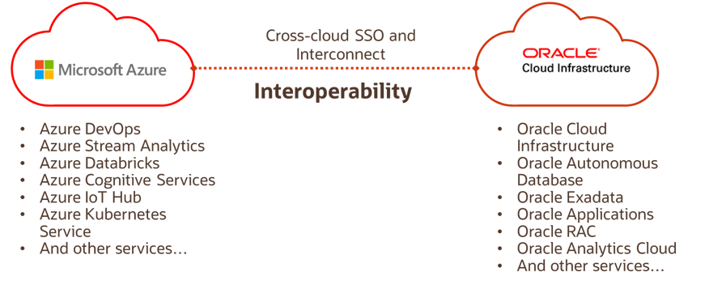
What does the partnership include: Three Pillars
1. Technology integration
Private interconnect with FastConnect and ExpressRoute
Unified identity and access management
2. Application interoperability
Tested, validated, and supported application deployments
Innovate across clouds
Large choice of services
Leverage existing investments
3. Collaborative support model
Joint, collaborative, standard support model
Seamless issue resolution
Customers can contact either Microsoft or Oracle when encountering an issue
+

Slide 36
Common Use-cases
Supported Deployments:
Full stack Oracle or custom applications on Oracle Database on OCI and Full stack apps on Azure that interoperate and share data
Oracle Apps (PSFT, JDE.,) on Azure using Oracle Database on OCI
Custom .NET application on Azure using Oracle Database on OCI
Custom Cloud Native applications on Azure using Oracle Autonomous DB
Applications/Oracle Database in OCI, Azure Data Lake for analytics & Cognitive Services for AI
SQL Azure, SQL Server, SQL DW on Azure and Oracle Analytics Cloud, Data Science service on OCI
SSO, cross-cloud interconnect
App A
App B
App C
App D
Java
E-Business Suite
.NET
.NET
Oracle DB
Oracle DB
SQL Server
SQL Server
Oracle Cloud
Azure

Slide 37


Architecture - Azure OCI Interconnect
ORACLE CLOUD INFRASTRUCTURE (REGION)
Availability Domain 1
Availability Domain 2
AD3
Subnet A
10.0.0.0/24
Subnet D
10.0.3.0/24
Bastian Server
Loaded Balanced
Web Servers
Virtual Machine
Bare Metal
Compute
VGW
Dynamic Routing Gateway
Virtual Machine
ExpressRoute
Subnet B
10.0.1.0/24
Subnet C
10.0.2.0/24
Host subnet
172.16.0.0/24
Primary Database
Standby Database
Azure VNet
172.16.0.0/16
FastConnect
Azure Region
Database System
Database System

Slide 38







Where are we connected
June 2021: 8 Azure Interconnect Regions
SWEDEN
LONDON
NEWPORT
AMSTERDAM
TORONTO
FRANKFURT
MONTREAL
FRANCE 2
ZURICH
CHUNCHEON
CHICAGO
FRANCE
SAN JOSE, CA
SPAIN
ITALY
SEOUL
TOKYO
PHOENIX
ASHBURN
ISRAEL 1
NRI 1
ISRAEL 2
OSAKA
NRI 2
SAUDI 2
DUBAI
MEXICO
JEDDAH
OMAN
UAE 2
MUMBAI
HYDERABAD
SINGAPORE
Commercial
VINHEDO
Commercial Planned
SAO PAULO
Government
JOHANNESBURG
Government Planned
SANTIAGO
SYDNEY
Dedicated Region
ADC
Dedicated Region Planned
MELBOURNE
Microsoft Interconnect Azure
Microsoft Interconnect Azure Planned

Slide 39
Your network requirements

Slide 40
Advanced Network Topics

Slide 41
DRG Routing Engine
Design
Each VCN, FastConnect, IPSEC, or RPC connection is “connected” to the DRG via an Attachment.
Each “Attachment” has a route table assigned, which directs ingress traffic to a specific egress attachment.
Operation
A Packet arrives from VCN or on-premise into the DRG
The DRG routing engine determines which Attachment to egress the packet out of based on the associated route table.

Slide 42
DRG Enhancements: Remote On Ramp
FastConnect or IPSEC VPN in Region (A)
Able to access resources in Region (B)
Uses the OCI Private backbone.
Can also provide redundancy.

Slide 43
DRG : ECMP (Active/Active) support
OCI now support “ECMP” for Active/Active load sharing.
Bundle up to (8) IPSEC or FastConnect connections.
Enabled on a per-route table basis.

Slide 44
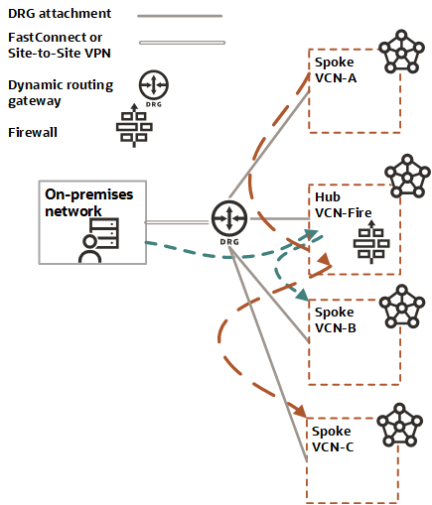
DRG: L3 Firewall
All traffic between VCNs is routed via L3 NVA (Network Virtual Appliance – or Firewall)
Routing tables are used to direct traffic via a specific VCN, and the DRG-attachment routing table forces all traffic to the NVA.

Slide 45
Redundancy: Connectivity Model
FastConnect POP Location 1
Customer Edge
Oracle Edge
Virtual Circuit 1
Router 1
Router 1
Virtual Circuit 2
Router 2
Router 2
Cross-connect Group
(LAG)
Virtual Circuit
Cross-Connect
(Physical Connection)

Slide 46
Transit POP redundancy
FastConnect POP Location 1
Customer Edge 1
Oracle Edge 1
FastConnect Redundancy
Virtual Circuit 1
Router 1
Router 1
FastConnect POP Location 2
Customer Edge 2
Oracle Edge 2
Virtual Circuit 2
Router 1
Router 1
Cross-connect Group
(LAG)
Virtual Circuit
Cross-Connect
(Physical Connection)

Slide 47
Layer 2 Partners : Megaport, Equinix, CenturyLink
Oracle requires redundancy with Partners
FastConnect Redundancy
OCI Region
Partner X
Network
Oracle POP 1
Customer responsible for
redundancy
Router 1
Customer DC
Virtual Circuit -1
PE
CPE
PE
PE
Oracle POP 2
Virtual Circuit -2
Router 1
BGP Session

Slide 48
Layer 3 Partners :Verizon, BT
Oracle require redundancy with Partners
OCI Region
FastConnect Redundancy
Partner X
Network
Oracle POP 1
Customer responsible for
redundancy
BGP Session-1
Router 1
Customer DC
Virtual Circuit -1
PE
BGP Session-2
Router2
CPE
BGP Session
PE
BGP Session-1
Oracle POP 2
Virtual Circuit-2
PE
Router 1
BGP Session-2
Router2

Slide 49
Private Peering network design
Routing Protocol
OCI currently supporting BGP(Border Gateway protocol) as a routing protocols for FastConnect connectivity to connect to partners as well as customers
BGP is standardized exterior gateway protocols designed to exchange routing and reachability information between ASNs
BGP is open standard protocol supported by all hardware vendor
BGP IP address assignment
Customer/L3 Provider can use any /30 or /31 ip address that they want to use.
This IP address is used for point to point addressing as well as BGP peer addresses

Slide 50
Private Peering network design contd..
BGP ASN
Similar to public and private addresses there are private (64512- 65535) & public ASN(1 - 64511) allocation
OCI only supports 2 byte ASN
The BGP ASN for OCI will be 31898 regardless of region
Customer can use any ASN that they comfortable using
LAG Support (Cross-Connect Groups)
You can aggregate multiple physical links in to a single logical channel based on IEEE 802.3ad also known as LACP (Link Aggregation Control Protocol)
LAG provides Link level redundancy and OCI always recommend partners and customer to build LAG even with Single physical member so when we have to scale up there is no downtime

Slide 51
Private Peering network design contd.. (2)
BGP Authentication
OCI supports BGP authentication mechanisms like Message Digest5 (MD5) algorithms. When authentication in enable any TCP segment belonging to BGP exchanged between peers is verified and accepted only if Authentication is successful.
Most types of authentication require administration and can disproportionately consume router resources as a result. OCI doesn't recommend using it unless customer have hardcore requirement.
OCI will not use MD5 with partners
Prefix-Acceptance
OCI will accept any-prefix advertise by customer over the FastConnect BGP session
No restriction on prefix-length
The only limit is number of prefixes(2000) that customer can advertise over the VC/BGP session

Slide 52
Public Peering network design
BGP IP address assignment
In contrast to FastConnect-private, Customer’s Layer 3 point-to-point interface will be part of shared Internet routing-instance instead of unique DRG routing-instance.
Because of customers is going to share same routing-instance we need to make sure that the IP addresses are unique.
OCI will assign the point to point IPs from range(169.254.0.0/16)
BGP Prefix-advertisement
OCI will advertise all the public prefixes for specific region customer is peering with
Public prefixes will include IP ranges that covers all public service offering by OCI
Public prefixes will also covers all the customer’s public VCN host prefixes

Slide 53
Public Peering network design contd.
BGP Prefix-acceptance
Customer provides list of prefixes that they want to advertise via console
OCI accepts the public-prefixes only if prefixes are owned by customer.
OCI Check multiple Internet Route Registry database(Using Dyn tool) to verify who owns the prefixes before accepting the prefix from the customer.
BGP ASN
OCI will use 31898 ASN
Customer needs public ASN to peer with OCI

Slide 54
Oracle Cloud always free tier: oracle.com/cloud/free/ OCI training and certification:
oracle.com/cloud/iaas/training oracle.com/cloud/iaas/training/register-for-training.html oracle.com/cloud/iaas/training/certification.html OCI hands-on labs: ocitraining.qloudable.com/provider/oracle Oracle learning library videos on YouTube: youtube.com/user/OracleLearning
Copyright © 2019, Oracle and/or its affiliates. All rights reserved.

Slide 55
Thank you

